Slide 1


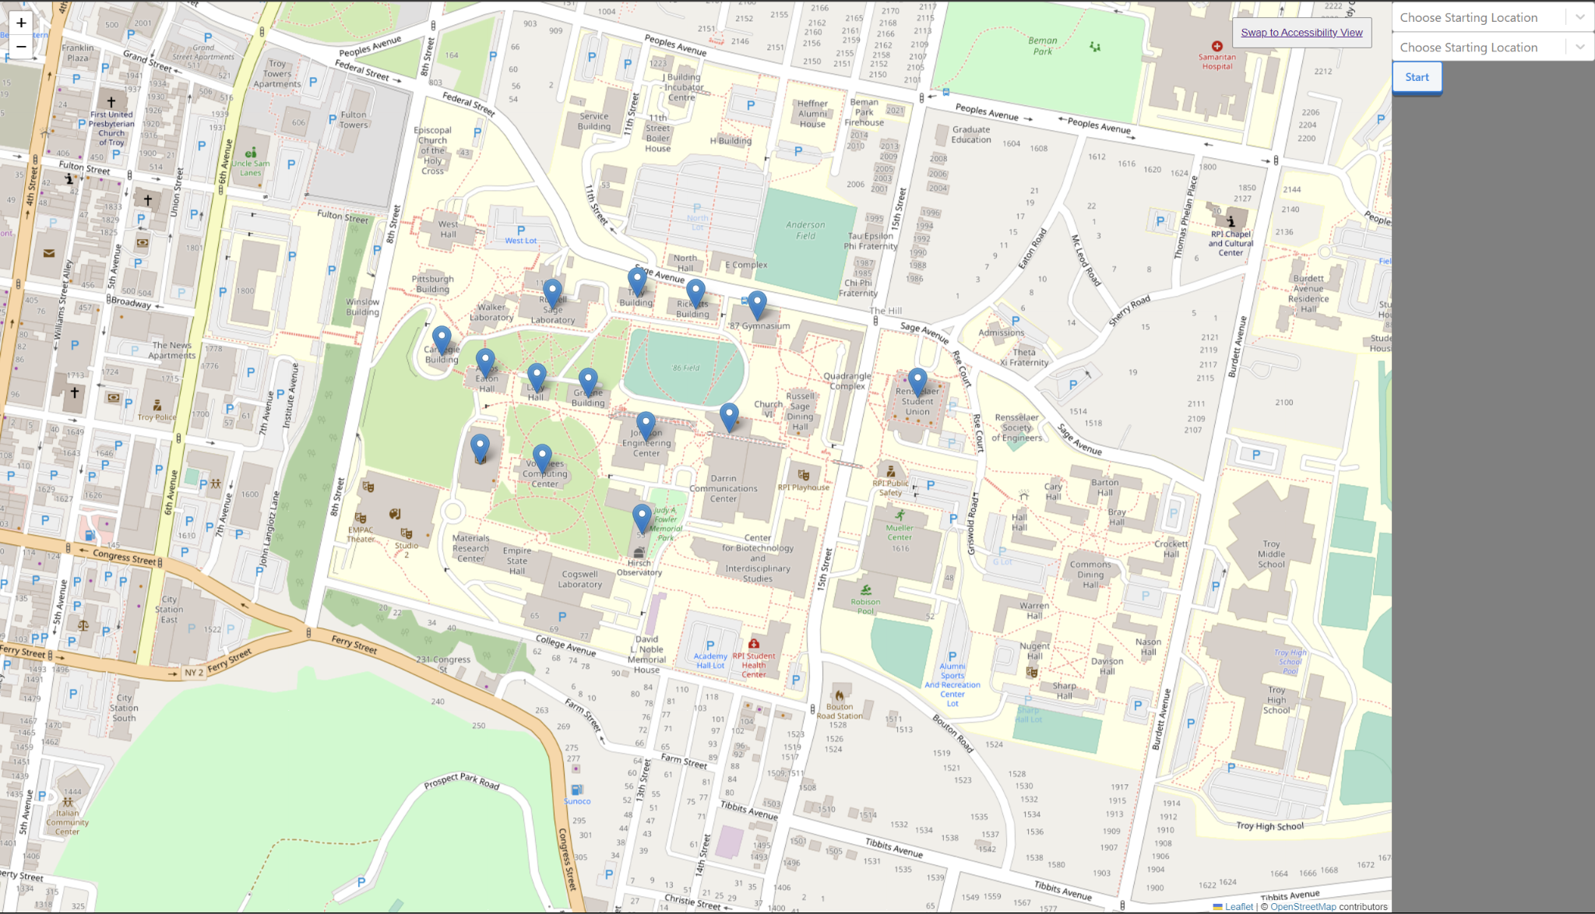
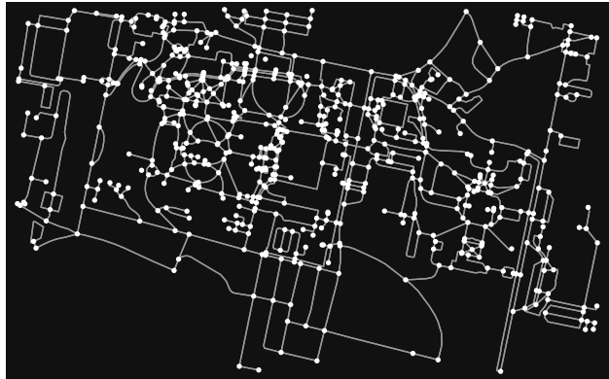
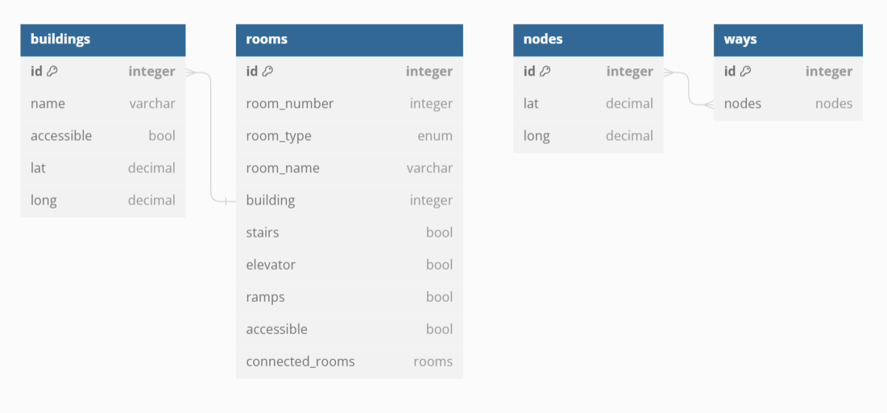
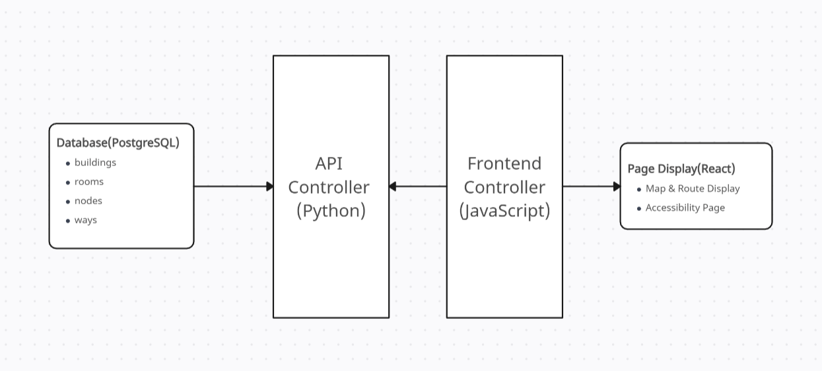
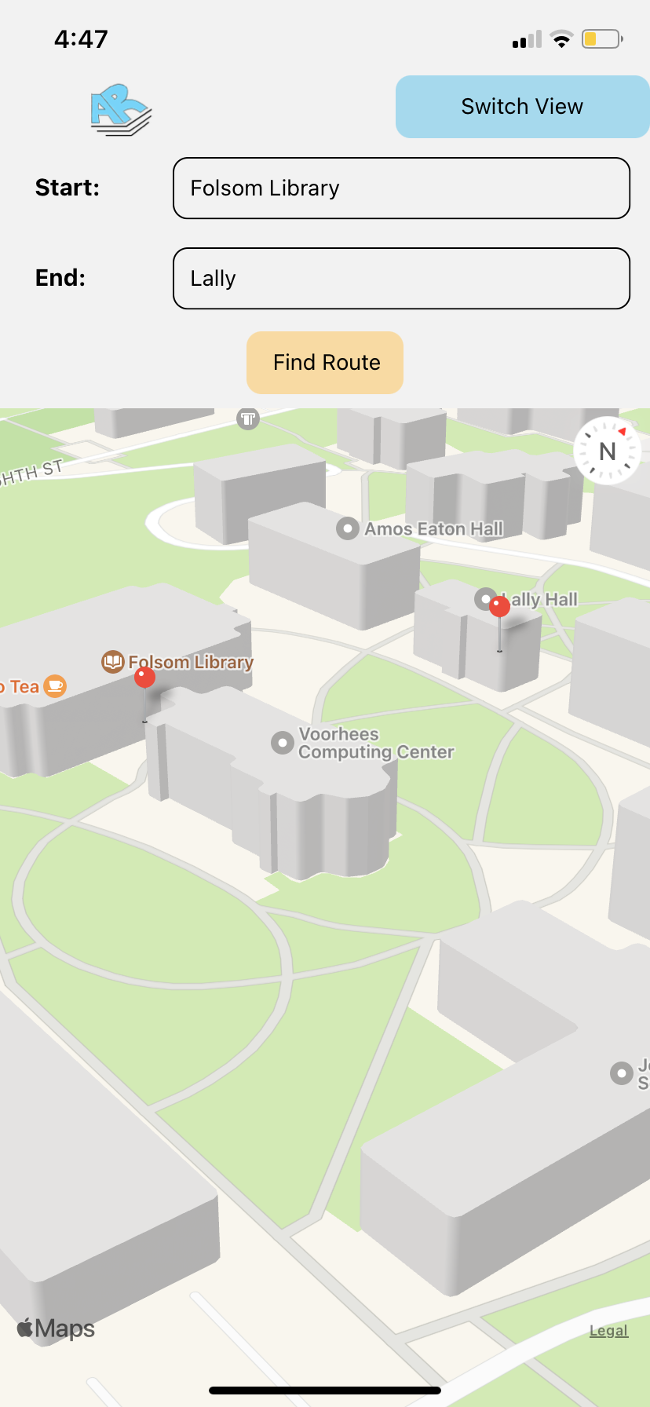
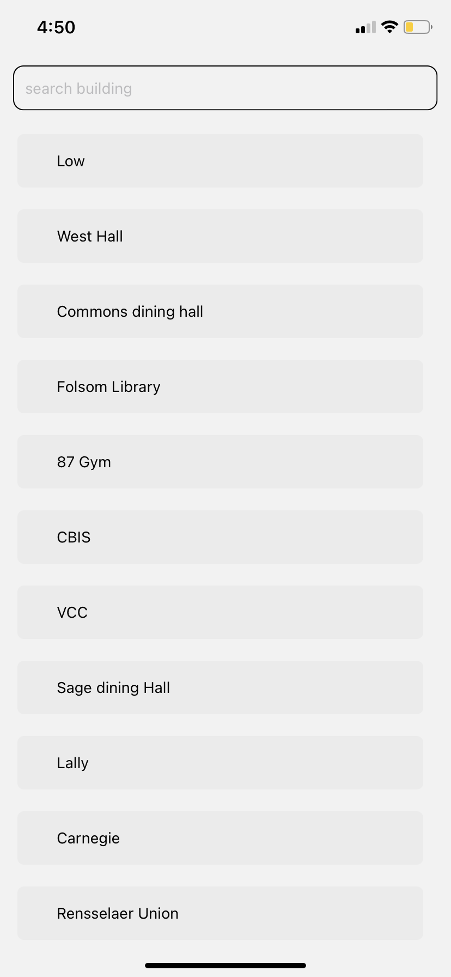
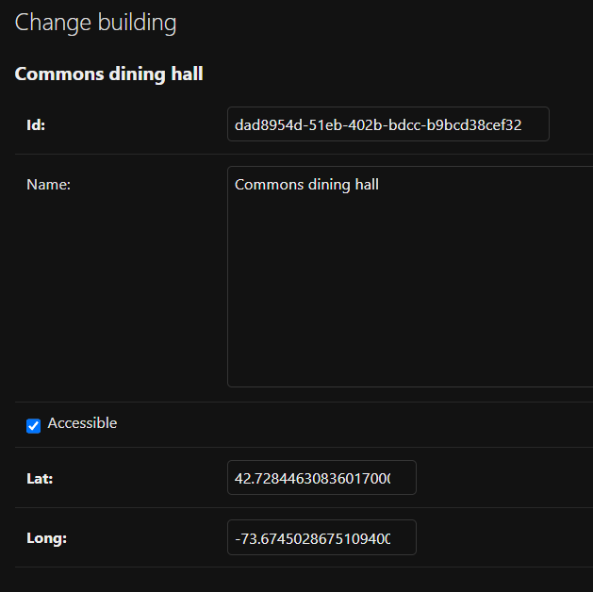
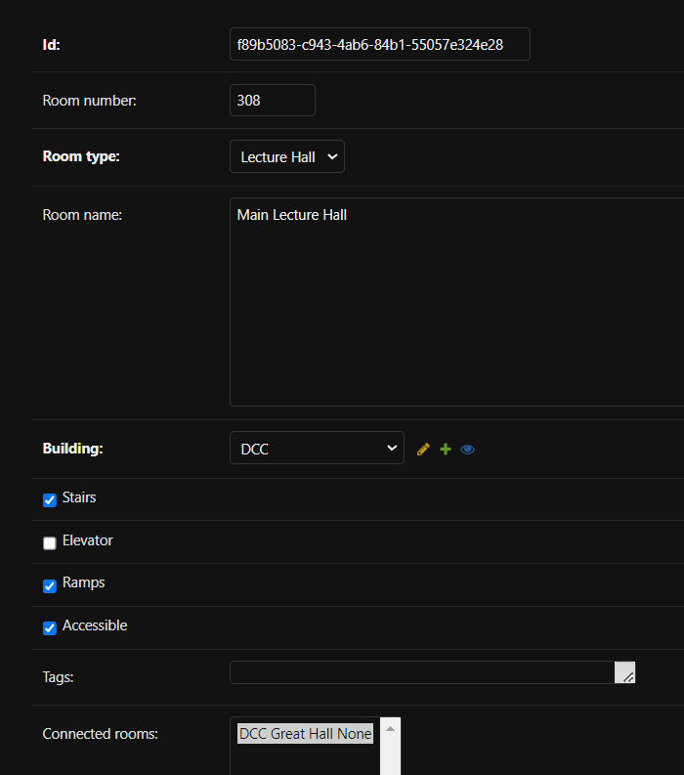
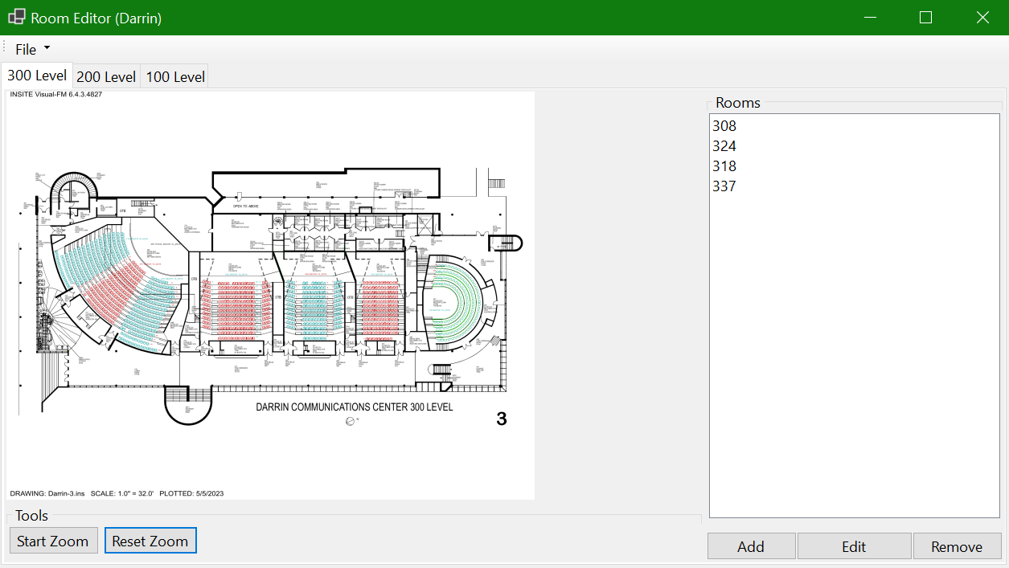
ACCESSIBLE ROUTES
Providing students with a guide to navigating a less-than-accessible campus
By Jason Jacobs, Tyler Du, Eddie Poon, Matthew Merritt, Mike Newby, Anthony DiGiovanna, Ben Dennison
INTRODUCTION
BACKEND — DATA AND DATABASE
FRONTEND
ROUTING
Accessible Routes was designed in conjunction with the Disabled Students at Rensselaer Club as an application to help physically disabled students navigate between their dorms, dining halls, classes, and extracurriculars, in order to provide a more equitable RPI experience.
Users will be able to use the website to choose buildings starting location and a destination from drop-down menus, and will either be presented with an accessible route, or be informed that there are no accessible routes between those two locations. The website will also help users locate an accessible way to find their room within the destination building - and inform them of any difficulties they may face. The interface will consist of a map as well as an information tab with information on what buildings are accessible. In the future, we hope to add time estimates for paths (will also add a feature to alter the estimate based on the speed of the user). We also plan to add path warnings for steep hills, where wheelchair buttons are and whether or not they work, information about winter snow clearing, and more. Finally, we plan to include routing to bathrooms by gender (mens, womens, gender-inclusive).
The objective for our data collection was to take the floor plans of RPI academic buildings (images) and implement them into software that we created in order to create a way to efficiently input data on each building into our database. We already had data for getting around campus. The challenge here was figuring out the best format to take the data in for graph creation. We use a combination of OSMnx for querying the data from OpenStreetMaps, as well as GeoPandas to properly format our data and convert it into a graph.
For each room, we stored the room number, floor number, building name, room type (classroom, staircase, etc.), and a couple more as seen below in the graph. However, only the floor number, building name, and room type are easily accessible to us and so we do not have complete data for the other categories yet.
Accessible Routes backend application is designed using relational database principles to provide a flexible and scalable architecture. Using a PostgreSQL database, there are 4 main tables or types of objects: Rooms, Buildings, Nodes, and Ways. Rooms and Buildings represent rooms and building that are defined by RPI while Nodes and Ways are nodes and pathways we have identified as accessible and used for the routing of students.
In order to give accessible routes inside of buildings, we needed a way to get the connections between interior rooms and any accessibility challenges that may be present. Manually inputting the layout of each building on campus would take forever, so a different solution was needed. A tool was created to make data entry easier. As shown below, the user can choose a floor plan image as a reference and quickly add rooms and their connections. When every room has been entered, the user can export the data in a format that can be used by the rest of the project.
The frontend is currently being developed for both a website and a mobile platform (IOS and Android) using React and React Native respectively. Each platform this semester focuses on a separate aspect of navigation, with the website platform focusing on navigation inside of buildings and the mobile platform focused on navigation between buildings.
The website currently contains two pages. One is a map page, with some buildings marked and two search bars. Once the routing is finished, the user should be able to press the button and have the route shown to them. The second page is an accessibility page, where the user chooses a building from a dropdown menu and the website will tell them if the building is internally accessible.
For routing, campus is represented as a weighted bidirectional graph where each edge has a weight equal to its length. For outside routing, a longitude, latitude plane is utilized to provide accurate distance measurements..
To create this graph, OSMnx, a python module used to represent locations as graphs is used. This information is queried from OpenStreetMaps using RPI’s address, and is then converted to a graph of nodes and edges where each node represents a point of interest and each edge represents a walkway. While we are able to query outdoor data for general information, the mapping of entrances that are accessible must be done manually. While it has not been implemented yet, indoor routing functionality will be implemented based on the measurements given in floor plans. This graph will be generated using our building graphing tool.
STRUCTURE
The development could generally be divided into four parts: the database structure design and data entry, the backend API that controls the database with HTTP, the frontend UI design, and the map display and routing functions. We have constructed most of the database component as well as the API, and have begun integrating the two systems.
The Application Programming Interface (API) is made using the Django REST framework. It is designed to connect the routing algorithm to the PostgreSQL database with a variety of pre-made queries, such as getting the accessibility data for each specific room on campus a student may be wanting to route to. More queries include getting the route to the rooms and routes that only include certain features such as stairs, ramps, or elevators.
FUTURE PLANS
Website View
We plan to implement many features once the website runs successfully. Future features beyond basic functionality include:
Mobile application;
Combining indoor and outdoor navigation;
Location tracking during route;
Customizable accessibility factors. Different people have different needs, and some people can handle (for example) a few stairs but not a whole staircase.
Number of stairs allowed
Rough terrain
Steep ramps
Considering stairs inside rooms (for example, lecture halls) and routing to the bottom/top based on user preference.
Showing a 360 image of the inside of a desired room
The mobile version currently contains two pages. One page is a map page which shows the route between buildings once the routing is finished. The other page is a list of all buildings on campus, with a search feature that filters the buildings shown based on the text entered by the user.
ACKNOWLEDGEMENTS
To Sam Sussman-Randall: for initially coming up with the idea to represent campus as a graph of nodes and edges, and for helping guide the technical design.
To Eyri Pellerin and the Disabled Students at Rensselaer Club: for sharing their personal experiences and helping us understand what makes campus inaccessible.
To Kevin Smith and the Facilities Management Department for providing floor plans for us to use.
To The QuACS Team for the floor plans posted on their GitHub.
The above image represents a sample of the data taken from the admin page for Commons dining hall and DCC 308.
Mobile View

